Slide 1
Lesson objective
PbiS focus
Empathy (let others work)
Achieve (ask for help)
Title: Percent of amounts
Aim:
Determine percentage of amounts with appropriate technology
Plan:
Review percent to decimal
Notes
Conversion practice
Need whiteboards and calculators.

Slide 2
Review
Percent to decimal, divide by 100
How many zeros you got? Move that spot!
I do (% ➔ decimal)
10%
50%
97%
5%
1.4%
You do (% ➔ decimal)
25%
75%
55%
11%
4%
4.7%

Slide 3
Review mental calculations
To find the percent of an amount we have been using mental strategies, using 1%, 5% and 10%.
Find 1%, 5% and 10% of:
250
1000
245

Slide 4
Exercise books
Find 10%, 5% and 1% of:
$560
245L
1500m
54c

Slide 5
Steps for calculators
If 97% = 0.97
What is 100%?
Convert percent to decimal
Change OF to multiplication
Multiply decimal to amount

Slide 6
I do
Convert percent to decimal
Change OF to multiplication
Multiply decimal to amount
25% of 5400L
87% of $876
45% of 98m

Slide 7
We do
Convert percent to decimal
Change OF to multiplication
Multiply decimal to amount
43% of 560L
95% of 350m
32% of $76.40
150% of 230

Slide 8
Whiteboards
Convert percent to decimal
Change OF to multiplication
Multiply decimal to amount
30 % of 560L
21% of 87m
92% of $70
400% of 58cm
2.5% of 320mm

Slide 9
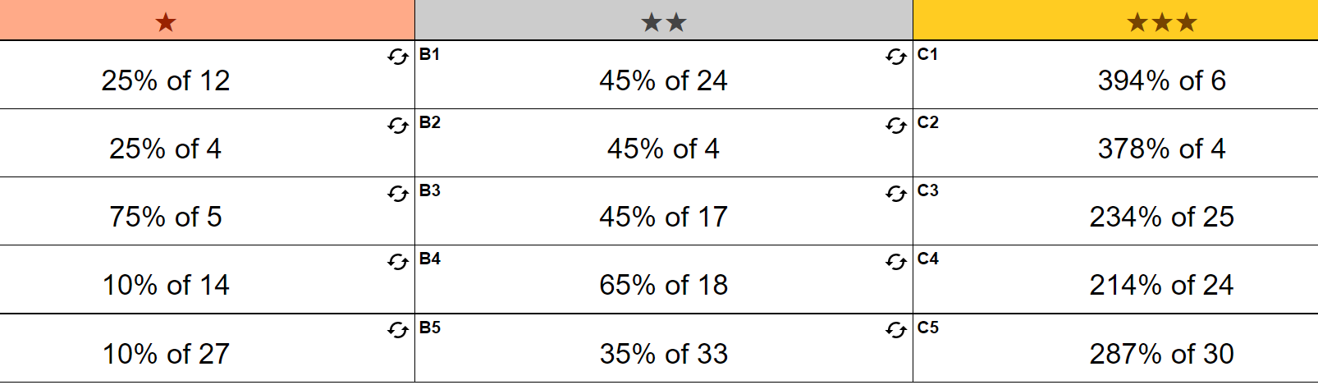

Slide 10
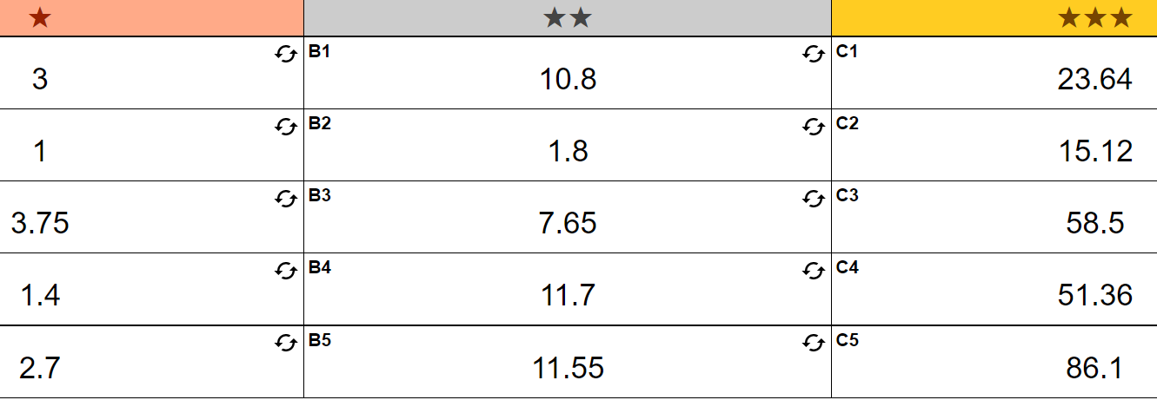

Slide 11
Fist to 5
What is 66% of 540?
3564
3.564
356.4
35.64
Aim:
Determine percentage of amounts with appropriate technology

